Slide 1
Business Etiquette 101
Authored by:
Patty Kirkley & Chuck Reece
Presented by: Patty Kirkley
October 21, 2010
Notes:
Etiquette is about having the ability to present yourself as someone who can be taken seriously. It is a critical attribute for professional growth. If you are perceived as someone who cannot be trusted not to embarrass yourself or maintain your control in business and social situations, you will likely not be successful.
There are many written and unwritten rules and guidelines for etiquette. You can avoid most mistakes by sticking to the basics you learned in kindergarten – always being courteous and thoughtful.

Slide 2
Why Do Employees Fail?
?
?
?
Notes:
Conduct quick exercise where students write their ideas

Slide 3
Why Employees Fail?
According to a Leadership IQ study, 46% of all newly-hired employees fail within 18 months
Why?
  26% Cannot Accept Feedback
  23% Unable to Understand or Manage Emotions
  17% Not Motivated to Excel
  15% Wrong Temperament for Job
  11% Lack Technical Skills
Notes:
Another study indicates that 40% of new hires do not work out because they cannot build good relationships with peers and subordinates.
(I recall a statistic in HR that 85% of employees who lost their jobs due to lack of personal skills not technical ability. Can’t cite source)

Slide 4
Top Roadblocks to Success
Don’t Know What to Expect
Don’t Understand Corporate Culture or Rules
Do Not Have A Plan
Cannot Accept Feedback
Stay with Past Ways of Doing Things
Share Too Much Personal Information
Behave in Rude, Boorish, or Arrogant Manner

Slide 5
Know What is Expected & Impress
Ask your New Boss for Help – Clarify Goals (understand how your performance/success will be evaluated)
Develop a Plan of Action and Review with Your Supervisor
Listen to Co-Workers and Get Them on Board with Your Plan
Meet as Many People as You Can (be friendly and build professional relationships but avoid getting overly personal)
Observe the Culture (find a mentor if you can)
Notes:
Do not give out too much personal information (political affiliation, church affiliation, opinions on social issues) – keep it professional.

Slide 6
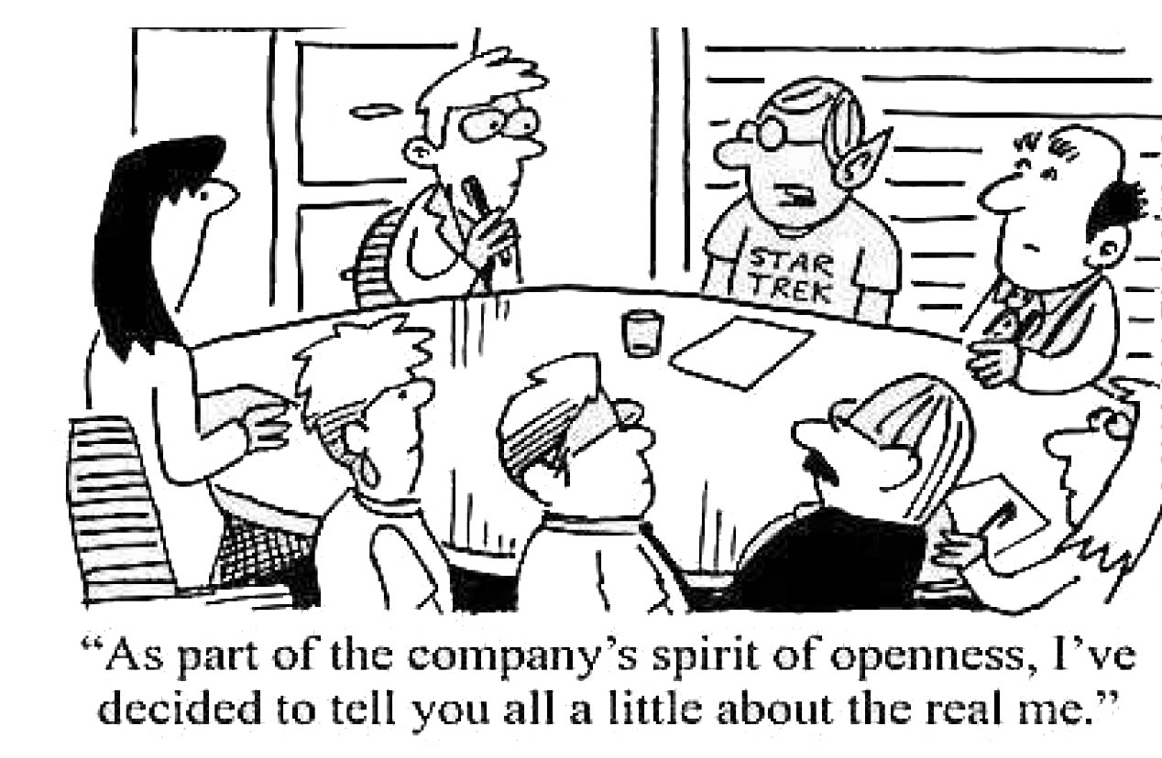
More Than I Wanted to Know…

Slide 7
Learn the Rules & Follow Them
Listen and observe carefully
Many new college grads fail because they were not told or do not know the rules or why they should follow them
  Be Punctual
  Wear the Expected Attire
  Don’t Immediately Ask for Leave Time
  Work Overtime if Needed
  Demonstrate Integrity
  Learn Chain of Command
Notes:
It is a good idea when you are a new employee to quietly observe your new work environment and get a solid grounding in how things work, who are the influencers are, who talks to who at the water fountain, who is not respected or liked. What do people wear? Is it a quiet office, or is there lots of banter and joking? Avoid faux paus.
Do not assume that a particular style of clothing is acceptable just because one person wears it – dress like the majority of employees and always try to be pressed and neat. Buy an iron and board!

Slide 8
Be A Team Player
Treat Everyone with Respect
Avoid Negativity (“That Won’t Work…”)
  Get Along with Others/Cooperate
  Volunteer
Notes:
Impressing the boss is not enough. One of the biggest gaffes that I have seen a new employee make is to treat clerical or cleaning staff in a demeaning manner. It will call attention to you, and it is not the kind of attention you want. These people may have the power to help or hinder your career. So treat everyone thoughtfully and with respect.
You also don’t boost your status in the work group if you are the habitual “nay” sayer who always finds a way to interject “that won’t work” or gives a hundred reasons not to try something new.
Probably the single most valued trait in an employee is someone who “plays” well with others – someone who cooperates and becomes part of the team. Someone who does not fit with the group is a manager’s nightmare.

Slide 9
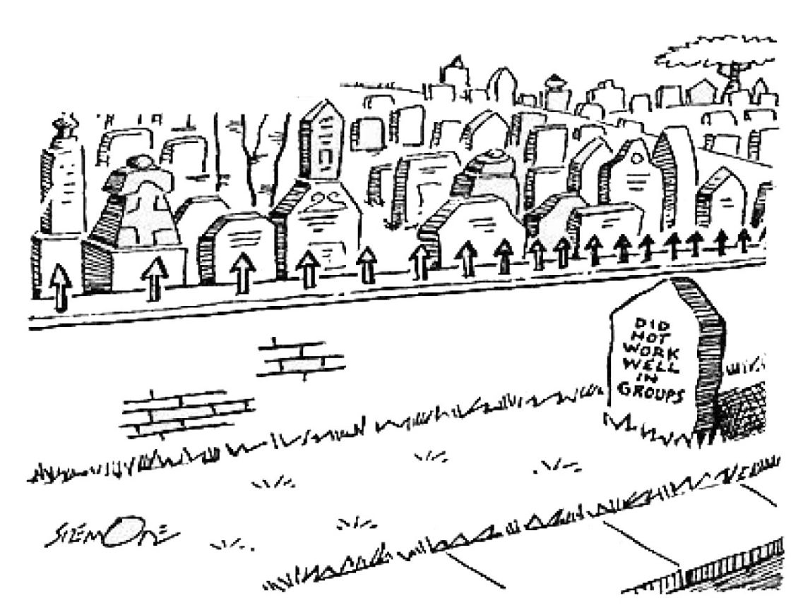
HR Professionals Say 80% Lose Jobs Because…

Slide 10
Have A Work Ethic
Don’t Ask the Same Questions Over and Over (take notes when you are learning new tasks)
Be Receptive to Learning (constantly learn new things)
Ask for New Assignments
Stay Busy … And Work Hard (find things to do)
Notes:
Employers expect workers to display work ethic and commitment. When you are a newbie and learning the job, take notes so you do not ask the same questions over and over again. Show enthusiasm and interest in learning new tasks. Be willing to take on new assignments.
Remember it is a job so stay busy and work hard. Coming in five minutes before the boss and leaving five minutes after the boss could be the wisest-spent ten minutes of the day!

Slide 11
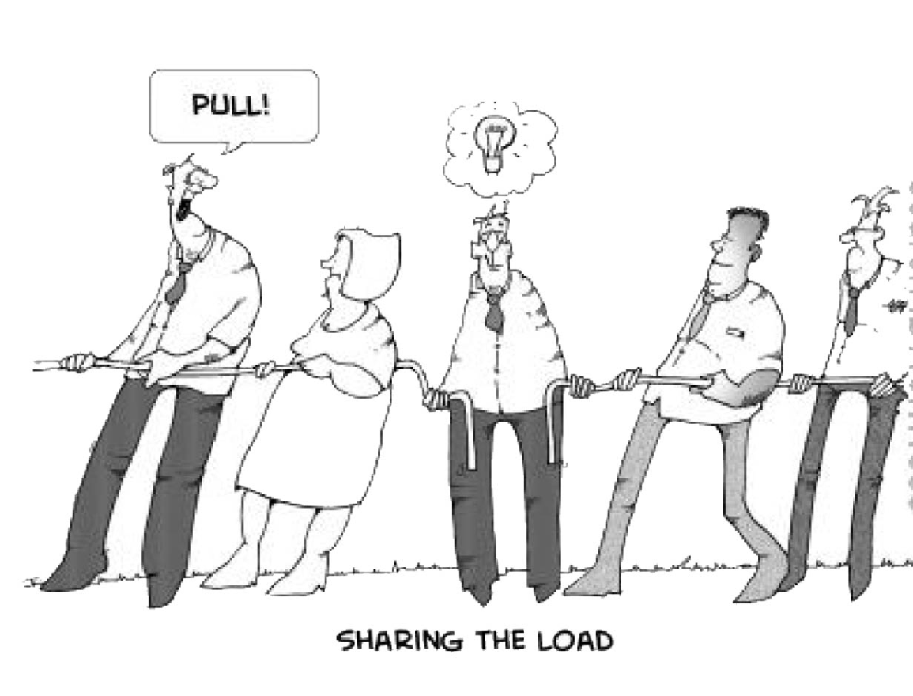
Do Your Share
Notes:
If you see a co-worker with a heavy work load, offer to help with something. If you can’t help with a specific technical task, try “Can I pick up lunch for you while I’m out?”

Slide 12
Take Responsibility
Own up to Mistakes
Do Not Worry if Someone Takes Credit for your Idea or Work
Learn to Accept Criticism and Make Changes Accordingly
Never Display Arrogance or Sense of Superiority
Notes:
It is your responsibility to:

Slide 13
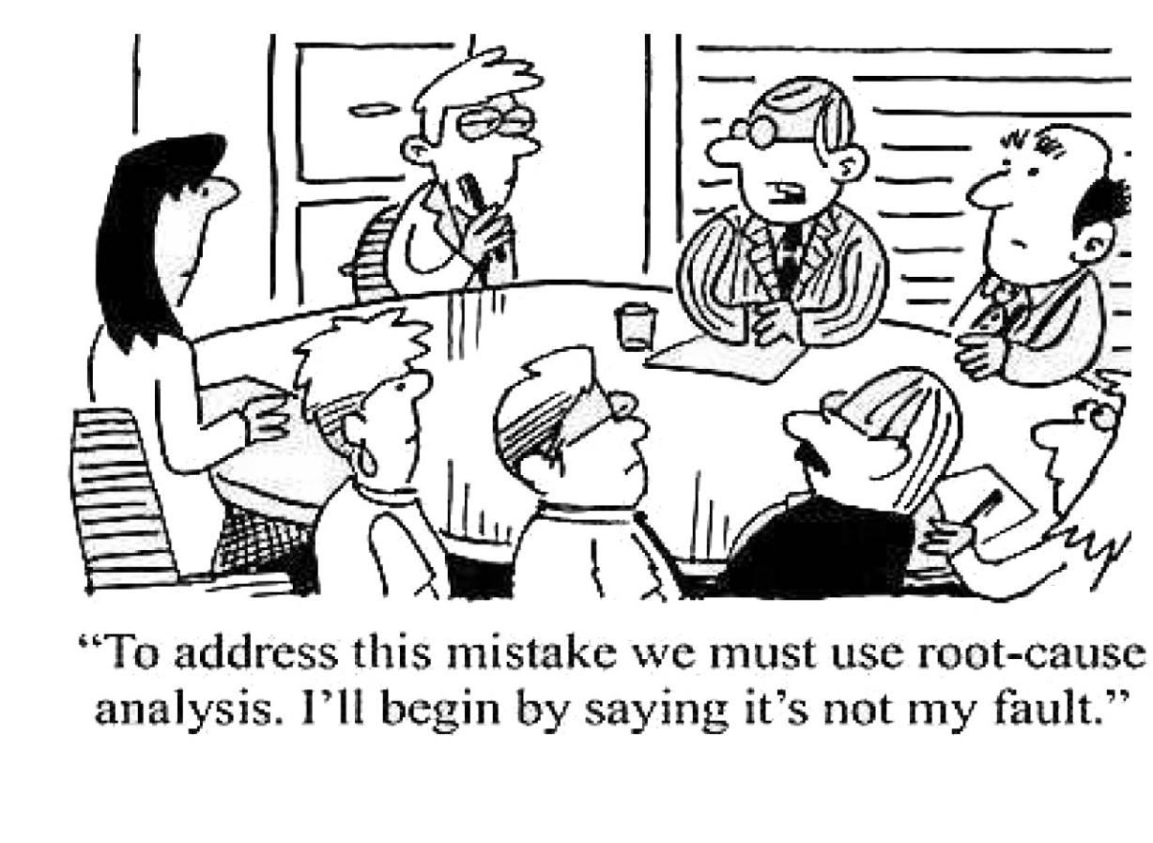
Own Up to Mistakes

Slide 14
Mind Your Manners
Greet Everyone and Smile
Be Polite – Please, Thank You, Good Job, and I’m Sorry are Powerful Words
Listen - Don’t Interrupt
Watch Your Language – You Never Know Who You Will Offend
Keep Your Cool – Even Under Stress
Resolve Conflicts Professionally (no vendettas or soap operas and never any backbiting or gossiping)
Notes:
Good manners still matter…

Slide 15
Appearance and Dress
Don’t insult your co-workers with sloppy, slovenly appearance
Err on the side of conservative until you understand the dress code; when in doubt, take the conservative route
Even in a “jeans” environment, take care with your grooming – clean, neat clothes, hair combed, nails trimmed and neat
Notes:
Close-toed shoes are preferable – no flip-flops under any circumstances!

Slide 16
Avoid Techno Traps
E-mail, Instant Messaging, Web Conferencing, Cell Phones, Texting…
“Nine times out of 10, what these new modes (of communication) have really given us are simply new opportunities to blow it!” – Peggy Klaus
Notes:
Technology is a wonderful thing when kept in check, but be careful that it does not cause you to blow it.
Employees who are chronically on the cell phone are seen as spending time on personal matters – this will hurt your chances for success.

Slide 17
E-mail Etiquette
Make the Subject Specific; Do Not Leave Blank or Generic
Fill in “TO” Just Before Sending
Be Very Wary of Reply to All
Delete Extraneous Information Before Forwarding
When Answering a Question, Copy It and Respond
Address and Sign your E-mails (you are dealing with people)
Do Not Type in All Caps
Check E-mail at Least Once Daily
Use Correct Grammar and Punctuation (no abbreviations)
Avoid Spam
Notes:
Some smart notes about e-mail
You never who is blind-copied or who your message will be forwarded to so assume that it will be in tomorrow’s newspaper!
Do not be the person who forwards jokes, political or religious statements, or chain mail. Co-workers will be offended and think you waste time.

Slide 18
E-Mail Final Tips
Vast Majority of Employers Monitor So Do Not Misuse
NEVER, NEVER Use E-mail in Confrontational Manner!
  It Is a Passive-Aggressive Approach to Conflict Management
  It Will Backfire and Make You Look Immature and Petty
  If Any Emotion in E-Mail, Hold It and Review Later
Notes:
If you find a back and forth conversation escalating, pick up the phone or drop-in instead. It will be more effective and you will be seen as someone who takes positive action.

Slide 19

Phone Etiquette
Always Return Calls (At Least Once Daily)
If Out of Office, Leave Message So Callers Know When to Expect Return Call
Identify Yourself and Your Organization When Making or Answering Calls
Personalize the Conversation; Always Smile
Never Be Rude
Notes:
Project warmth and enthusiasm when making or receiving calls.
Set up a professional voice mail message (you are not at home). Be sure that the caller does not get annoying messages such as mailbox full or get transferred to nowhere. If you are out of the office, leave a message so callers know when to expect a return call. Always return calls (at least once a day)
If leaving a message on someone’s voice mail, always leave a clear message and give your telephone number slowly (twice).

Slide 20

Cell Phone Etiquette
Leave Off or Put on Silent or Vibrate
Do Not Use “Cutesy” or Annoying Ring Tones
Limit Personal Calls to Emergencies or Important Calls
Make Personal Calls in Private
Do Not Take Your Cell Phone to the Restroom or to Meetings
Avoid Talking too Loudly

Slide 21
Texting for Business Purposes
No Text Speak
If Sending Group Text, Write to Most Formal Person in Group – Keep Language Appropriate to Audience
Check Spelling Carefully
Be Cognizant of Timing
Do Not Rely on Texting to Replace Other Forms of Communication
Notes:
For many young people, texting has become a preferred mode of communicating. Be careful not to rely solely on it for work purposes and use it appropriately.

Slide 22
Meeting Etiquette
Arrive on Time or Early
Sit Up Straight and Maintain Eye Contact with Speaker
Treat Everyone Equally
Pay Attention and Take Notes
Have Your Calendar
Participate, but Do Not Monopolize Meeting
If You are Leading Meeting, Have an Agenda
Thank People for Their Time and Participation
Notes:
Do not engage in side conversations or comments during meeting. Do not text or check e-mail during meeting – pay attention.

Slide 23
Why Business Etiquette?
In these changing times, it is important to
prepare for a variety of business and social
situations.
Your success depends on you…
  Your attitude
  Your composure and confidence
  Your etiquette skills
Notes:
Dr. Phil Weast, this is Sally Smith, our new work-study. Sally, Dr. Weast is the Dean of Student Services.

Slide 24
How Do Your Etiquette Skills Measure Up?
Business-Workplace Etiquette
http://sbinfocanada.about.com/library/bizetiquettequiz/bletiquettequiz1.htm
http://www.gradview.com/articles/careers/etiquette.html

Slide 25
References
“Business Etiquette for Networking Events.” Ravenwerks
Global Ethics, Etiquette, and Effectiveness. 30 Sept 09
<http://www.ravenwerks.com/?page_id=19>.
Bardwell, Chris. The Black Collegian; Special Graduation
Issue. Apr 02 <http://www.blackcollegian.com>.
Post, Emily. The Emily Post Institute; Etiquette’s Home on the
Web. <http://www.emilypost.com/business/index.
Klaus, Peggy. The Hard Truth About Soft Skills; Workplace Lessons Smart People Wish They Had Learned Sooner. New York: Harper Collins Publishers, 2007

