Slide 1
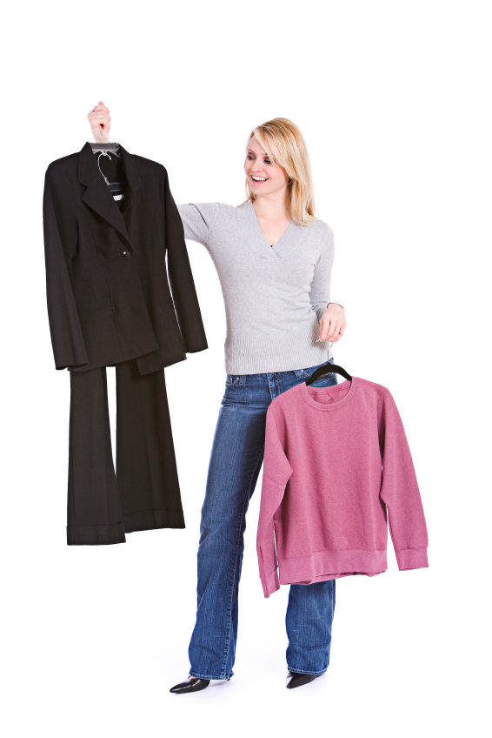
Dress for Success
Women’s Professional Dress for
Interviewing and Beyond…

Slide 2
Clothes make the man (or woman.) Naked people have little or no influence on society ~Mark Twain

Slide 3
Why Does It Matter?
http://www.youtube.com/watch?v=kBxRi_udy9I
Marketing yourself
55% of another person’s perception of you is based on how you look (Image Dynamics, 2009.)
First impressions
46 % percent of 3,200 hiring managers reported that job candidates were dressed inappropriately (Career.Builder.com.)

Slide 4
The “Language of” Dress for a work place
Business Dress- conservative and business like
-skirt suit with jacket
-pants suit with jacket
-tailored blouse or tailored knit top
Business Casual-pants or skirts, tailored shirts or blouses, sweater or sweater set

Slide 5
Business Dress Examples
pantsuit dress attire
-good quality wool blend or washable twills
-choose classic colors like black, navy, gray, or brown
-avoid trendy styles, stick with a classic cut
-you can mix and match for multiple outfits

Slide 6
Business Dress Examples
skirted suit
-skirt should be at least knee length
-no high slits

Slide 7
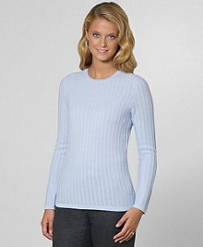
Tops
What goes under a suit?
-blouse, sweater separate, shells
-select a matching or neutral color like white, off white, beige, or another light color
-look for cotton, a cotton blend, knit, or a quality fabric blend
-make sure that your top does not expose cleavage and is not sleeveless

Slide 8
Business Dress Examples

Slide 9
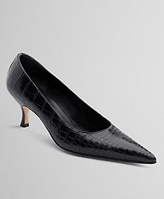
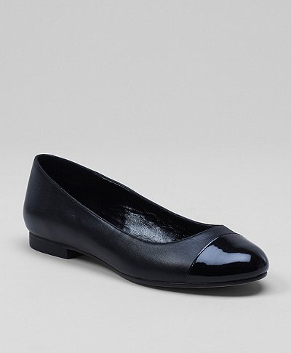
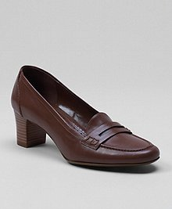
Shoes and hose
Shoes
-flats, loafers, or pumps
-Leather
-black, navy, brown
-closed toe
-heels should not be extremely high
Hose
-skin colored or darker
-no pattern
-no runs (if you can help it!)

Slide 10
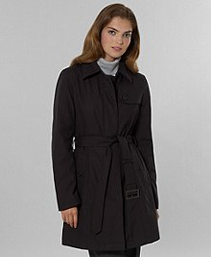
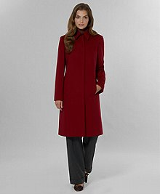
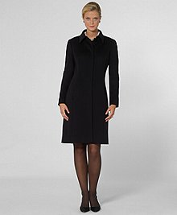
Outerwear
-rain coat
-dressy winter jacket

Slide 11
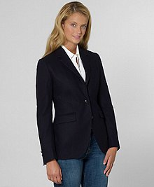
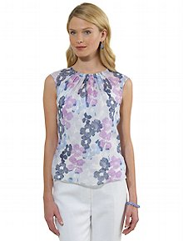
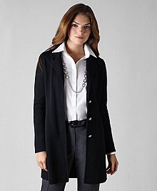
Business Casual
-pants or a skirt
-tailored shirts
-sweater sets
-knit sweaters
-jeans (if your work place allows)

Slide 12
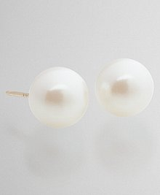
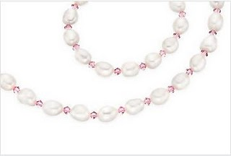
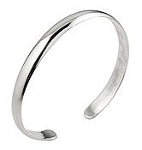
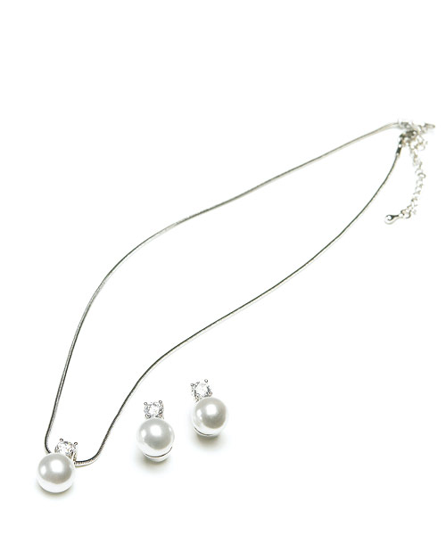
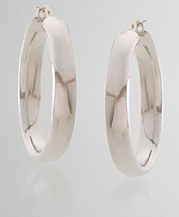
Accessories
-keep jewelry minimal
-small studs work best
-pearls, gold, or silver
-only one earring per ear
-stay away from large earrings, necklaces and rings
-remove non-tradtional jewelry, such as nose rings, eyebrow rings, spacers, and tongue or lip rings
-cover visible tattoos that could be offensive

Slide 13
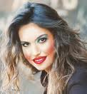
Hair and Make-Up
-stay conservative and natural
-less is more
-pick natural and neutral make-up collars
-nails should be clean an neat
-hair should be clean and brushed
-longer hair should be pulled back
-don’t use an over abundance of perfume
-fresh breath is a must

Slide 15
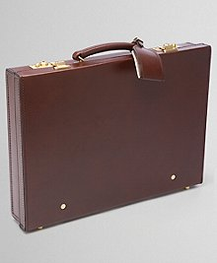
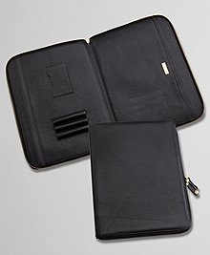
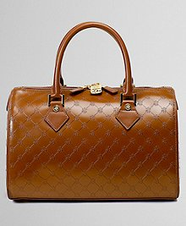
Handbag, brief case or portfolio bag
Handbag, brief case or portfolio bag????
This will depend on you and what you need to bring to the interview. Keep the handbag fairly structured as opposed to overly slouchy. The briefcase and portfolio should also be structured and clean!

Slide 16
General
Make sure your clothes fit properly
Attire should be clean
Shoes should be polished
Crack is whack!!! No cleavage, no backside or toes should be showing at the interview.
No strong perfumes. May people are allergic to certain scents.
Remove all tags and extra buttons from new clothes
Sun glasses on top of your head or headphones: Be sure to remove all your transit gear.

Slide 17
GOOD LUCK!!!
Dominique Benson
Admissions
d_benson@southwestercc.edu
828.339.4217

