Slide 1
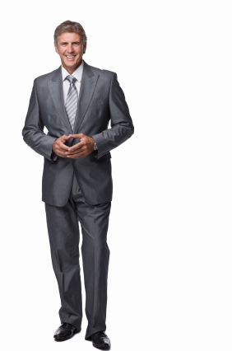
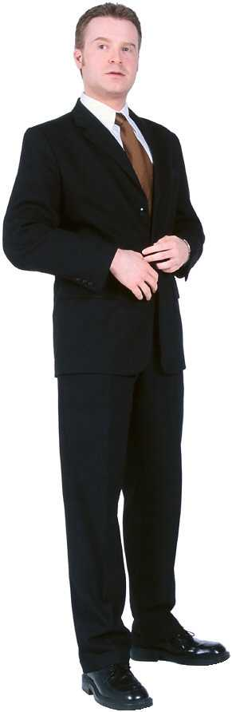
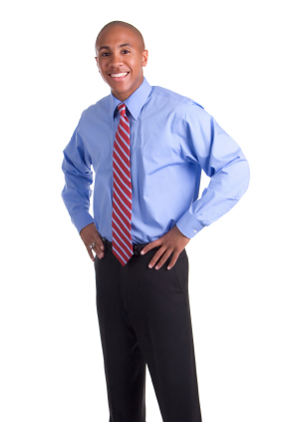
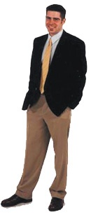
Dress for Success!
Men’s Professional Dress for Career Advancement
Presented by Thom Brooks, Vice President for Instructional Services

Slide 2
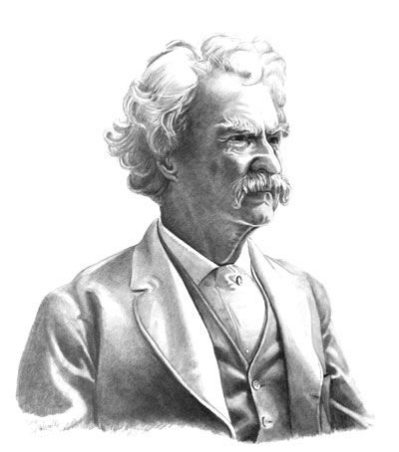
Clothes make the man. Naked people have little or no influence on society.
-- Mark Twain

Slide 3
Why does it matter?
People may form perceptions about you and your abilities based on clothing and body language:
  Professionalism
  Level of sophistication
  Intelligence
  Credibility
  Motivation
  Job Knowledge

Slide 4
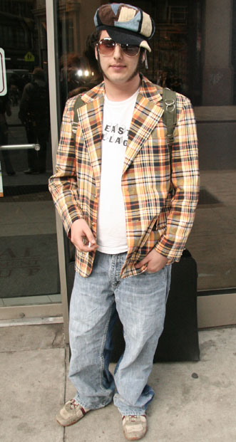
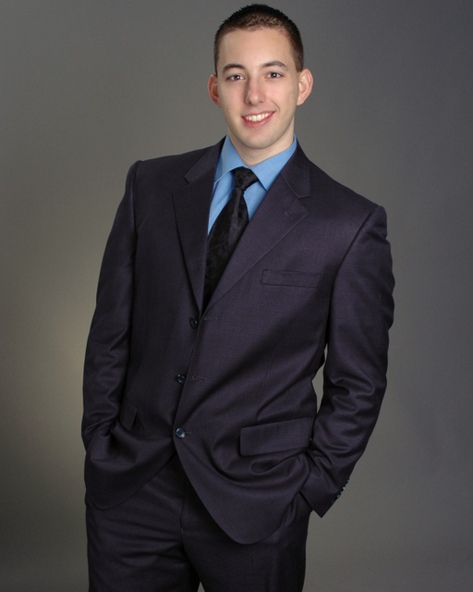

Slide 5
So what is appropriate dress to make a good first impression?
Dress “one notch” above the norm - know your audience
Select styles and colors that complement your appearance
Pay attention to details of attire and grooming
Be confident in your appearance

Slide 6
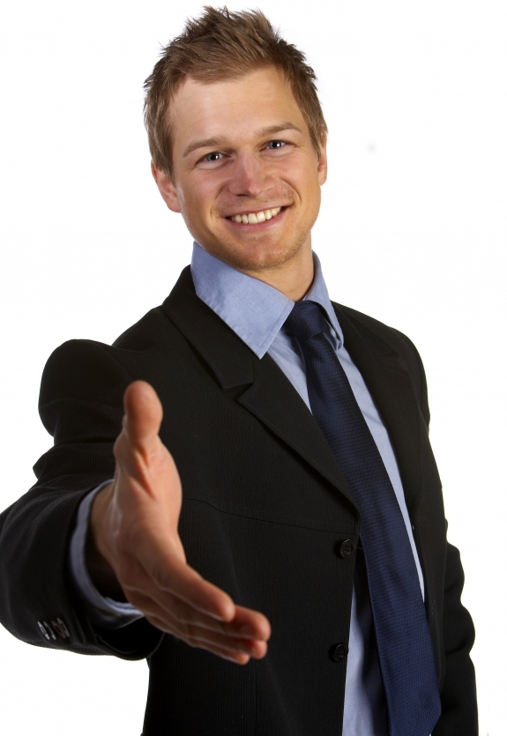
What are the “norms” of dress for your audience?
Them: Jeans, polo shirts
You: Slacks, dress shirt
Them: Slacks, dress shirt
You: Sport coat, tie
Them: Sport coat, tie
You: Suit

Slide 7
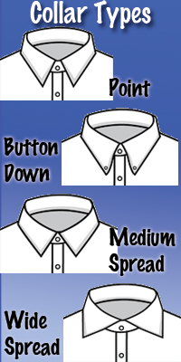
Select styles to complement your appearance
Facial Shape

Slide 8
Select styles to complement your appearance
Facial Shape

Slide 9
Select styles to complement your appearance
Facial Shape

Slide 10
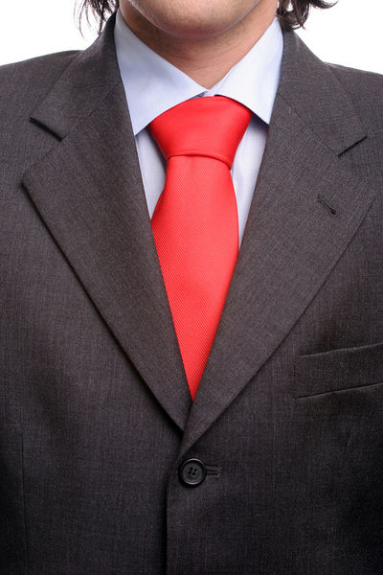
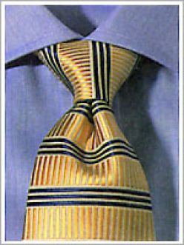
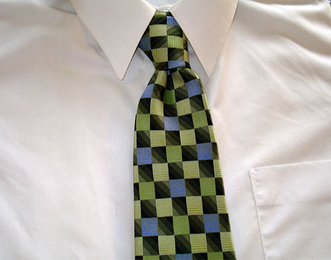
Select styles to complement your appearance

Slide 11
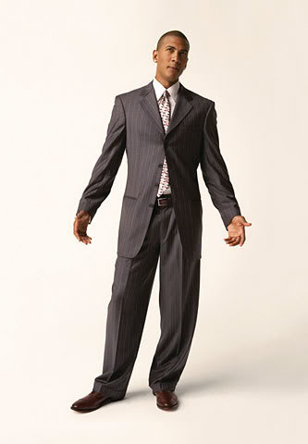
Select styles to complement your appearance – Suits for Tall, Slim
Do’s:
Patterns and Solids
Sport Coats
Cuffs
Pleats
Double vents
Goal:
Broaden
Don’ts:
Open jackets
Deep gorges
Cautions:
Flat front pants
Solid ties with solid suits
Stripes

Slide 12
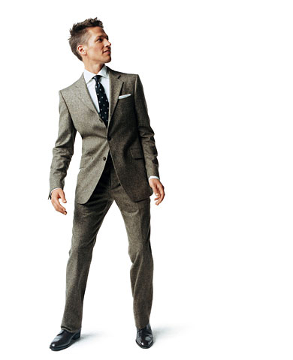
Select styles to complement your appearance – Suits for Shorter men
Do’s:
Solids and Stripes
Unbuttoned Jacket
3 Button coats
Unvented coats
Goal:
Lengthen
Don’ts:
Cuffed pants
Patterns
Double-breasted
coats
Cautions:
Pleat front pants
Sport coat and pants

Slide 13
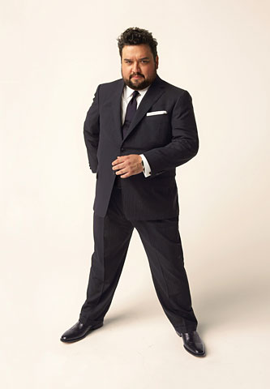
Select styles to complement your appearance – Suits for Heavy set
Do’s:
Solids and Stripes
Darker colors
Unbuttoned Jacket
2 Button coats
Narrow lapels
Goal:
Lengthen and slim
Don’ts:
Patterns
High button suits
Double-breasted coats
Cautions:
Pleat front pants
Cuffed pants

Slide 14
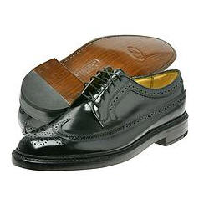
Pay Attention to the details!
Grooming:
Neat hair
Clean nails
Facial stubble
Coordinating:
Belt & Shoes
Socks & pants
Metals & Jewelry
Attire:
Shirt neatly pressed
Clean and lint free
Shoes polished, touched up
Laces tied, tightly
Socks are long enough

Slide 15
Be confident!
Dress appropriately for your audience
Select clothing that complements your appearance
Practice dressing for success

